Slide 1
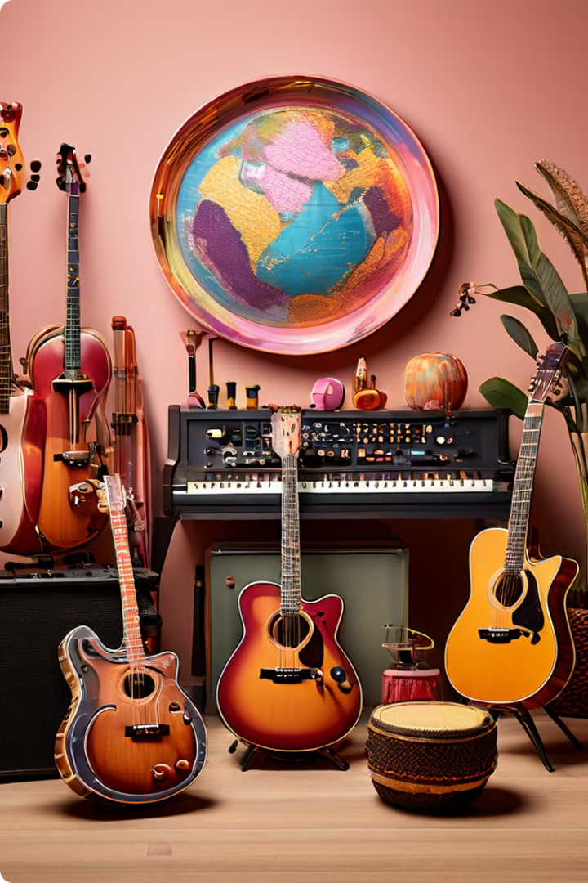
Traditional Music: Instruments and Their Cultural Significance
Traditional music is a vital part of human culture, expressing emotions, stories, and beliefs through sounds and rhythms. Instruments play a central role in these traditions, often reflecting the unique history and identity of their communities.
Timothy opio

Slide 2

Djembe Drum: Rhythmic Heartbeat of West Africa
Origins
Purpose
Cultural Significance
Originating from West Africa, particularly among the Mandé people of Mali, Guinea, and Senegal, the djembe is a goblet-shaped drum traditionally carved from a single piece of African hardwood and covered with animal skin.
It is used in various ceremonies, including weddings, harvest celebrations, and religious rituals. The drum’s sounds range from deep bass to high-pitched tones, creating complex rhythms that are integral to these celebrations.
The djembe's rhythmic patterns have a strong connection to traditional African dance and storytelling, serving as a powerful communication tool that unites communities.

Slide 3
Gamelan: Enchanting Orchestral Sounds of Indonesia
Instrument Family
Musical Style
Cultural Role
Gamelan is not a single instrument but a family of metallophones, drums, gongs, and other instruments, creating a rich and layered sound.
The music is characterized by intricate melodies, rhythmic patterns, and a unique scale system, resulting in a distinct and enchanting sound.
Gamelan music plays a central role in Indonesian ceremonies, rituals, and entertainment, reflecting the country's diverse cultural heritage.

Slide 4
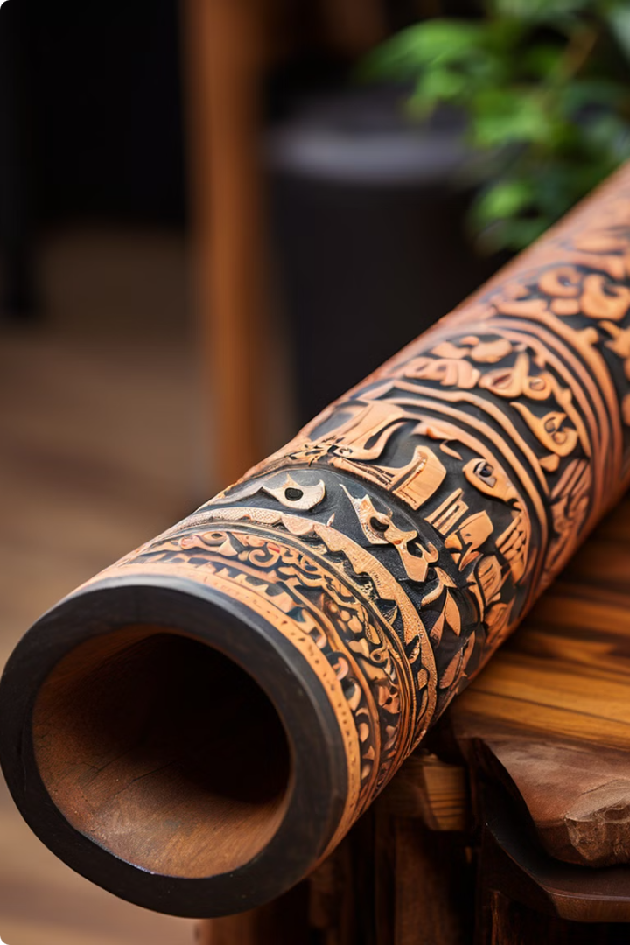
Didgeridoo: Resonant Drone of Aboriginal Australia
1
Origins
The didgeridoo, a long, cylindrical wooden instrument, is believed to be over 40,000 years old, making it one of the oldest musical instruments in the world.
2
Playing Technique
It is played by blowing air through the mouthpiece and manipulating the breath to create a continuous drone, often accompanied by rhythmic breathing techniques and other sounds.
3
Cultural Significance
The didgeridoo plays a significant role in Aboriginal culture, used in ceremonies, storytelling, healing rituals, and connection to the land.

Slide 5
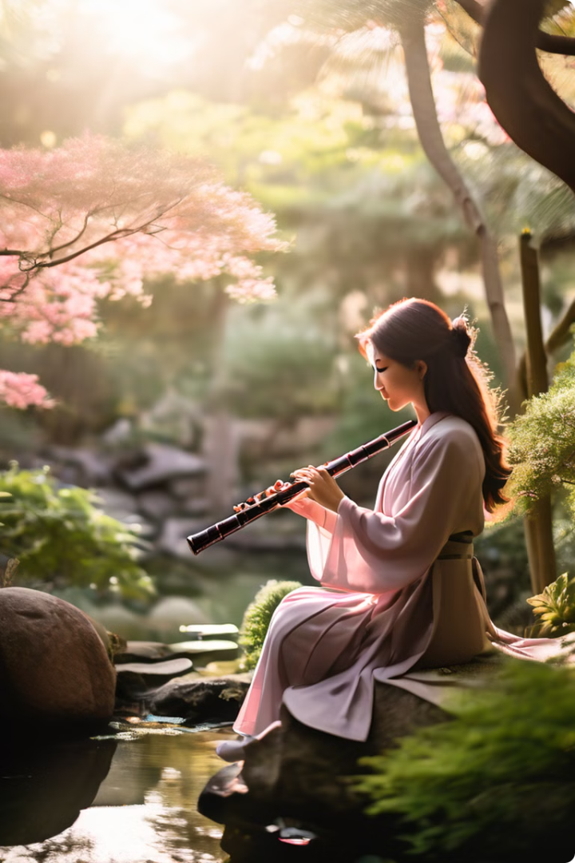



Shakuhachi: Meditative Bamboo Flute of Japan
Origins
The shakuhachi is a traditional Japanese bamboo flute, with a long and rich history dating back to the 14th century.
Musical Style
It is known for its simple yet profound melodies, often characterized by long, sustained notes and evocative, contemplative sounds.
Spiritual Connection
The shakuhachi is deeply intertwined with Zen Buddhism, often used in meditation and spiritual practices, symbolizing a connection to nature and inner peace.

Slide 6
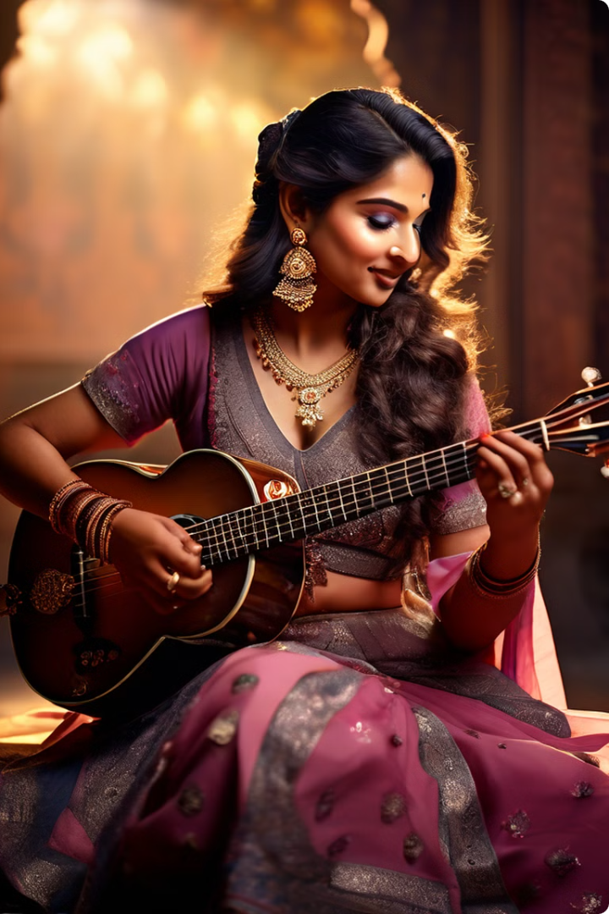
Sitar: Melodic Strings of Indian Classical Music
1
Construction
The sitar is a long-necked, fretted lute with a large resonating gourd, producing a warm, resonant sound with a unique vibrato.
2
Musical Style
The sitar is a cornerstone of North Indian classical music, known for its intricate melodies, rhythmic patterns, and improvisational style.
3
Cultural Role
The sitar's melodic beauty and expressive capabilities have made it a beloved instrument in Indian culture, playing a significant role in religious ceremonies, storytelling, and entertainment.

Slide 7

Bagpipes: Iconic Sound of Celtic Tradition
Region
Type
Characteristics
Scotland
Great Highland Bagpipe
Large, powerful sound, three drones, chanter with eight holes
Ireland
Uilleann Pipes
Smaller, more melodic sound, three drones, chanter with nine holes, bellows-powered
Brittany
Biniou
Smaller than Highland bagpipes, three drones, chanter with six holes

Slide 8

Preserving and Celebrating Global Musical Heritage
Traditional music, with its rich history and cultural significance, deserves to be preserved and celebrated for generations to come. It reminds us of our shared humanity and the power of music to unite us across borders and cultures.

